Slide 1
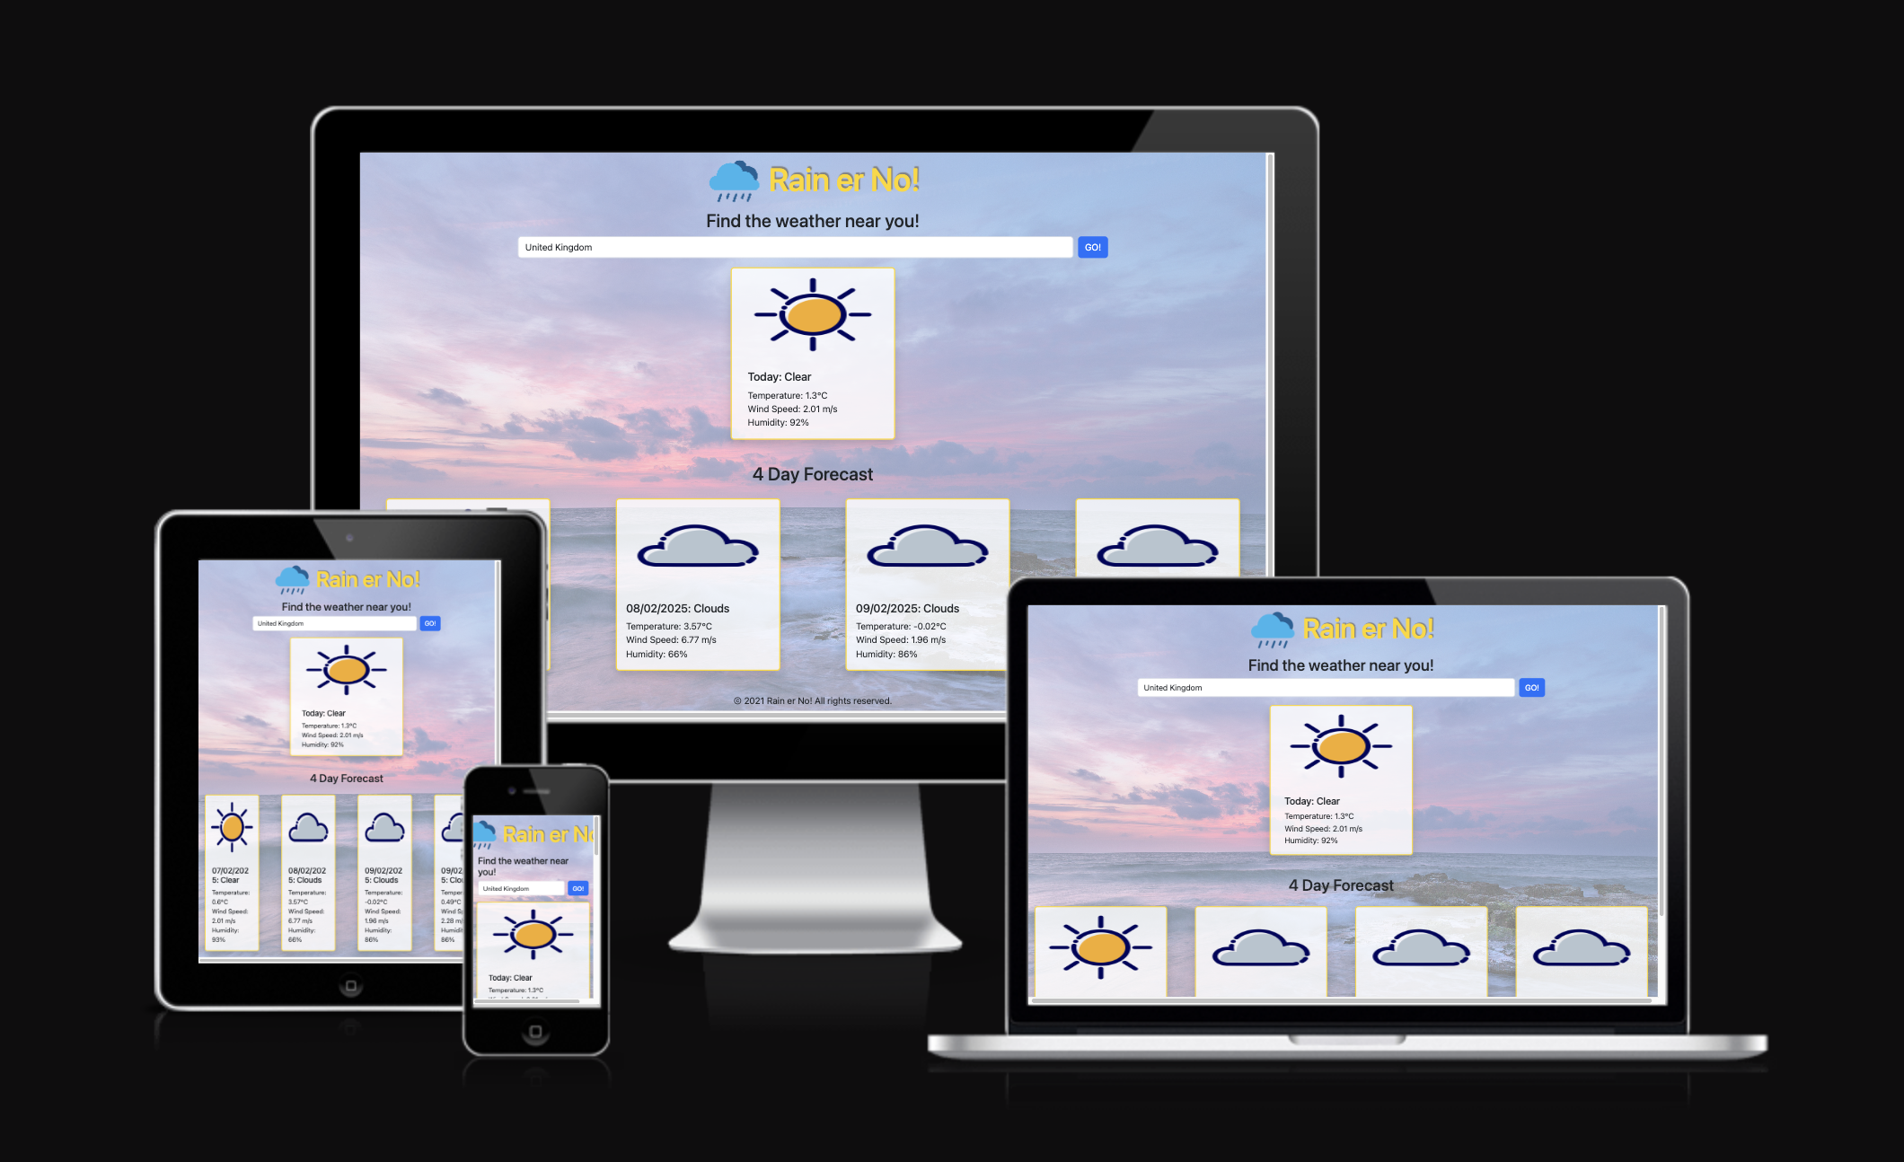

Weather App: Rain er No!
An interactive webpage that displays location-based weather information
Mizzle Makers!
Mark-Team Lead Jack Milo
Ollie
Notes:
Team Lead: Hi everyone. We are TEAM NAME composed of myself, Dev2 and Dev 3. We’d like to talk about our project PROJECT NAME TECHSTACK(HTML/BOOTSTRAP/JS/CSS/API) & TAGLINE

Slide 2
Planning & Design
Ideation
UX Design
Technologies
What did you hope build why did you want to build it and who is it for?
An on-demand weather app to meet demand for internet users to search for weather forecasts for a chosen location
User Stories: integrated with project board
Intuitive UI:
simplified webpage
Responsivity:
mobile-first design with use of Bootstrap
Accessibility: use of semantics
Interactivity: JS
Languages & Frameworks
Wireframing tool
KANBAN
Version Control
Libraries
Frameworks
HTML/CSS
JavaScript
Notes:
Team Lead discusses the following 1 minute

Slide 3
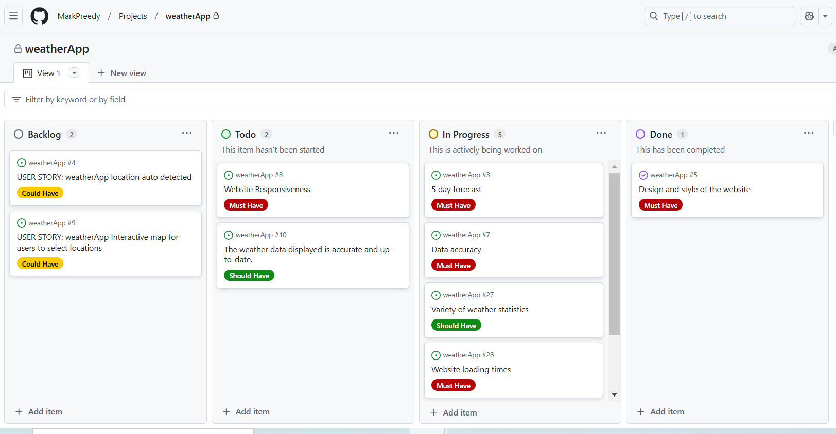
Project Board
Number of User Stories: 11 Assigned Tasks: 25
MoSCoW Prioritisation
AGILE (MVP)
Project Backlog: 3
Notes:
Team Lead discusses the Project board 30 seconds! Introduces Dev 2

Slide 4
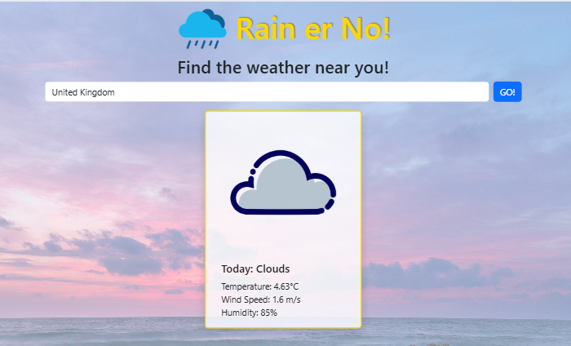
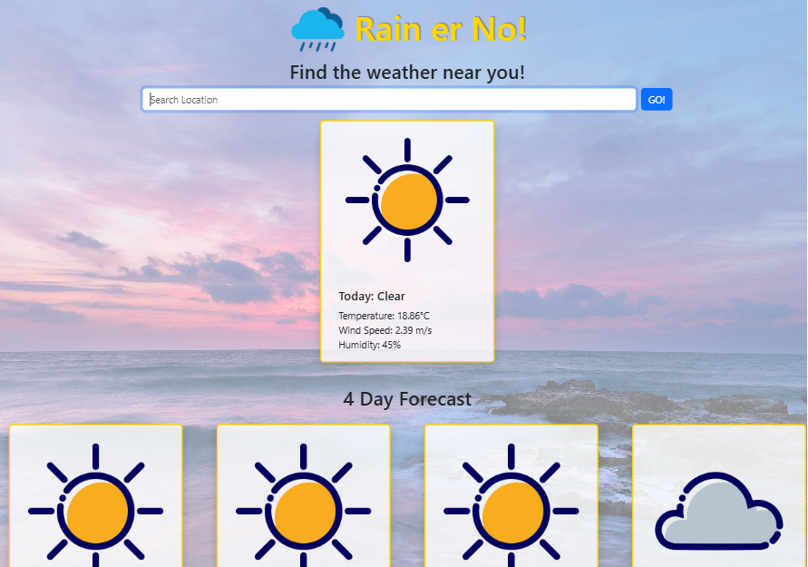
Features
Default Weather
Selected Location
Notes:
Dev 2 Discuss the MAIN FEATURES OF THE APP AT A HIGH LEVEL 1 minute

Slide 5
Deployed Project
Deployed Link: https://markpreedy.github.io/weatherApp/
Notes:
Dev 3 opens the link to the deployed project (Mention deployment process via github pages)and exhibits responsiveness, additional features and user experience.1 minute

Slide 6
Documentation, Testing & Version Control
GitHub Repository: https://github.com/MarkPreedy/weatherApp
Notes:
Dev 3 then opens Repo, and exhibits README touching on testing and deployment

Slide 7
Collaboration & Outcomes
Outcomes
Collaboration
Development Problems
Summary
Are you happy with the final product?
What do you hope to achieve in the next development cycle?
What would you do differently if you could start again?
Problems that arose during development?
In group conflicts and resolutions?
Did you find any of the behaviour related content useful? Teamwork, problem solving etc?
Overall group dynamic
Overall satisfaction
What we learned
Our experiences.
Notes:
All 3 Devs could maybe take a card each here.

Slide 8
Q&A
Notes:
Quick q&a 1 question each from the judges and any questions from the group.

